Slide 1
QuickBite Express: A Data-Driven Recovery

Slide 2
PROBLEM STATEMENT
  QuickBite Express is a Bengaluru-based food-tech startup (founded in 2020) that connects customers with nearby restaurants and cloud kitchens. In June 2025, QuickBite faced a major crisis. A viral social media incident involving food safety violations at partner restaurants, combined with a week-long delivery outage during the monsoon season, triggered massive customer backlash. Competitors capitalized with aggressive campaigns, worsening the situation.
  Go through the metadata and analyse the datasets thoroughly. This is the most fundamental step.
  Begin the analysis by referring to the provided questions and datasets. You can use any tool of the choice (Python, SQL, Power BI, Tableau, Excel) to analyse and answer these questions
  Suggest some recovery strategies

Slide 3
Datasets Given
Click Here for Datasets
dim_customer
dim_delivery_partner_
dim_menu_item
dim_restaurant
fact_delivery_performance
fact_order_items
fact_orders
fact_ratings

Slide 4
DATA CLEANING
For Data Cleaning refer to the link below👇
Click Here

Slide 5
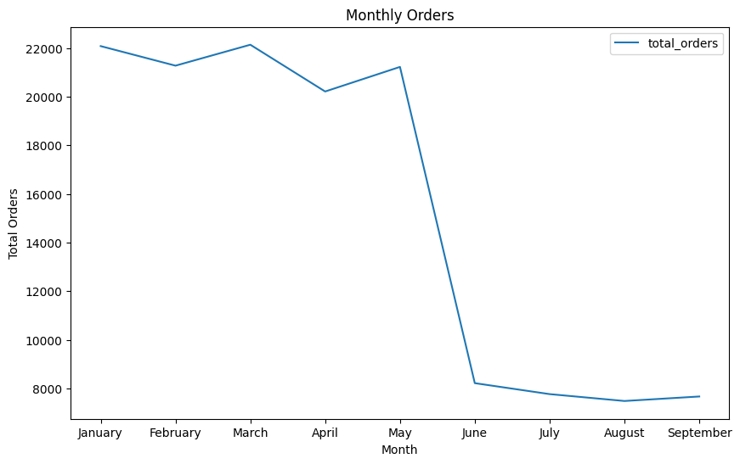
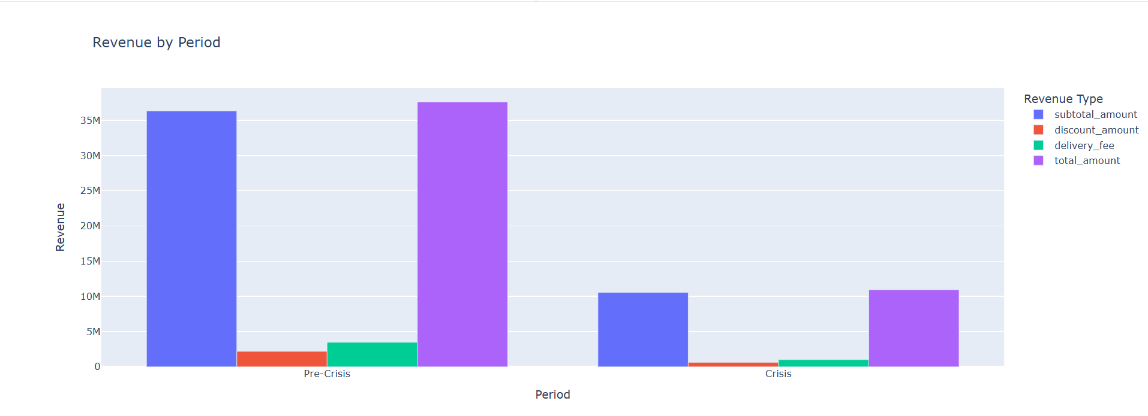
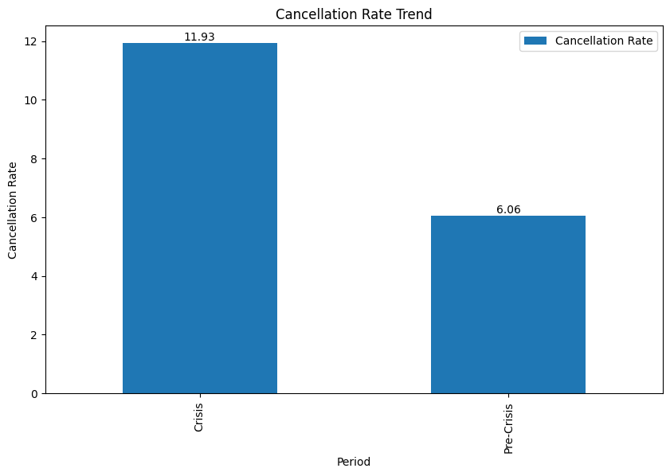
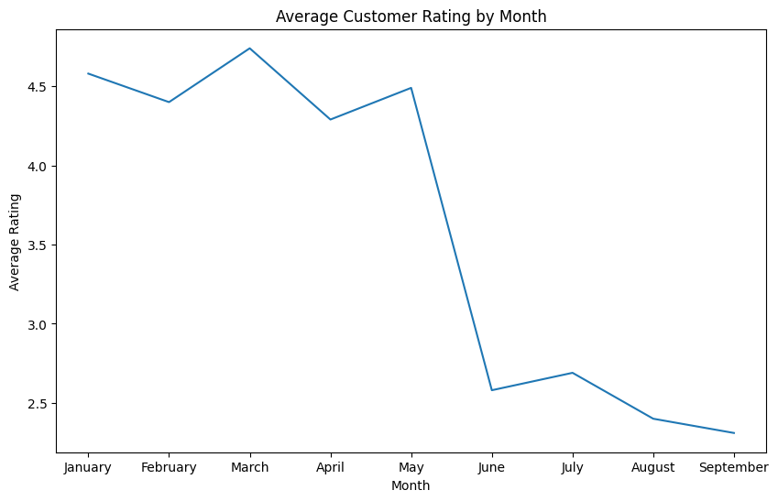
Executive summary
The Core Problem: 71% Revenue Collapse Driven by Operational Failure
  The Collapse: A massive, uniform 70.9% drop in revenue and orders across all major cities.
  The Insight: Average Order Value (AOV) remained stable. This proves the problem was not pricing, but a mass customer disengagement.
  The Root Cause: A complete operational breakdown. The average delivery delay more than doubled to 18.6 minutes (from 7.4).
  The Failure: The late delivery rate skyrocketed from 18% to 66.36% (two-thirds of all orders), even while handling only 30% of the original volume.
Immediate Consequences
  Cancellations Doubled: The fulfillment failure rate jumped from 6.06% to 11.93%.
  Ratings Collapsed: Average ratings fell from a stable 4.49 to a low of 2.58.
  Top Complaints: The 18.6-minute delay was the direct cause of the top complaints: "cold food," "late," and "bad quality.“
The Long-Term Damage: Catastrophic Loyalty Loss
  "Promoters" Wiped Out: We saw a 93% churn rate (26 out of 28) of our best, high-frequency "promoter" customers.
  Loyal Users Lost: In total, the company lost 84.5% of all high-frequency users.
The Chain Reaction
  Operational Failure: Delivery delays doubled to 18.6 minutes.
  Poor Experience: Delays directly caused "cold food" complaints.
  Reputation Collapse: Ratings plummeted from 4.5 to 2.6.
  Loyalty Wipeout: 93% of our most valuable customers churned.
Executive Conclusion: The crisis exposed a fragile operational model. The failure to deliver orders on time was the single spark that started a fire, leading to a near-total wipeout of brand loyalty.

Slide 6
Exploratory Data Analysis(EDA)
Monthly Orders
top 5 city groups experienced the highest percentage decline in orders.
Restaurant Analysis
Cancellation Analysis
Delivery SLA
Ratings Fluctuation
Sentiment Insights
Revenue Impact
Loyalty Impact
Customer Lifetime Decline

Slide 7
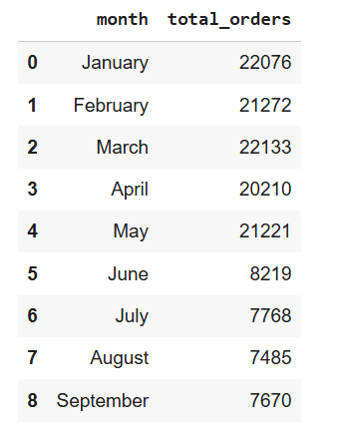
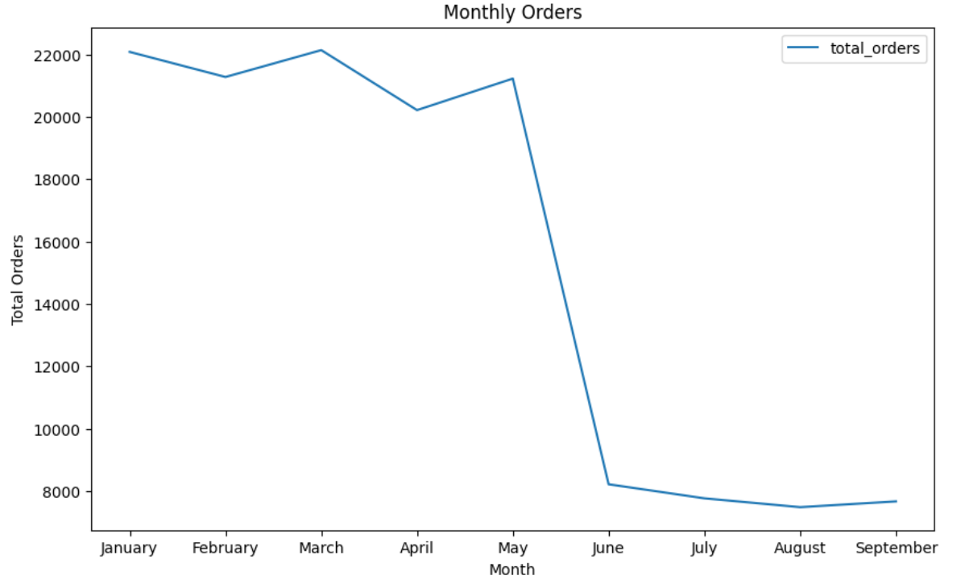
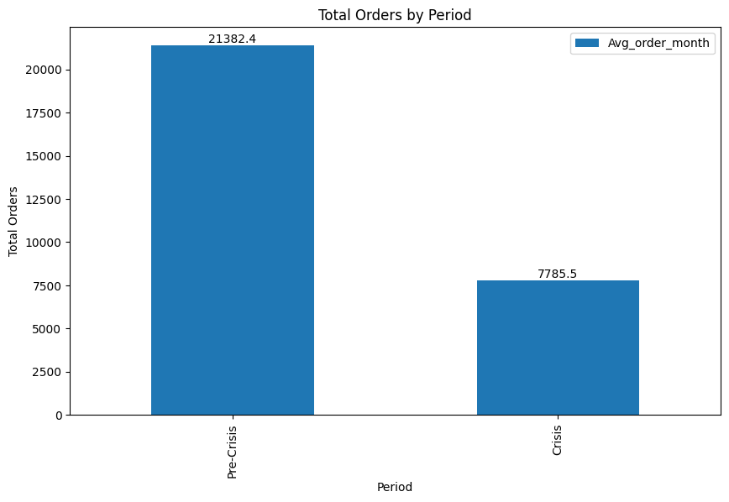
EDA -1 Compare total orders across pre-crisis (Jan–May 2025) vs crisis (Jun–Sep 2025)

Slide 8
EDA-1 insights
Pre-Crisis Average (Jan–May): Orders were highly stable, averaging 21,382 per month.
The Drop (June): Orders fell abruptly from 21,221 in May to 8,219 in June.
Magnitude of Decline: The June drop alone represented a 61.2% loss of monthly volume.
Crisis Average (June–Sept): The volume stabilized at a much lower baseline, averaging 7,786 orders per month.

Slide 9
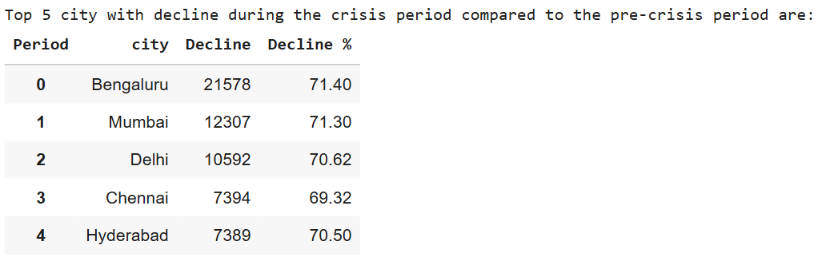
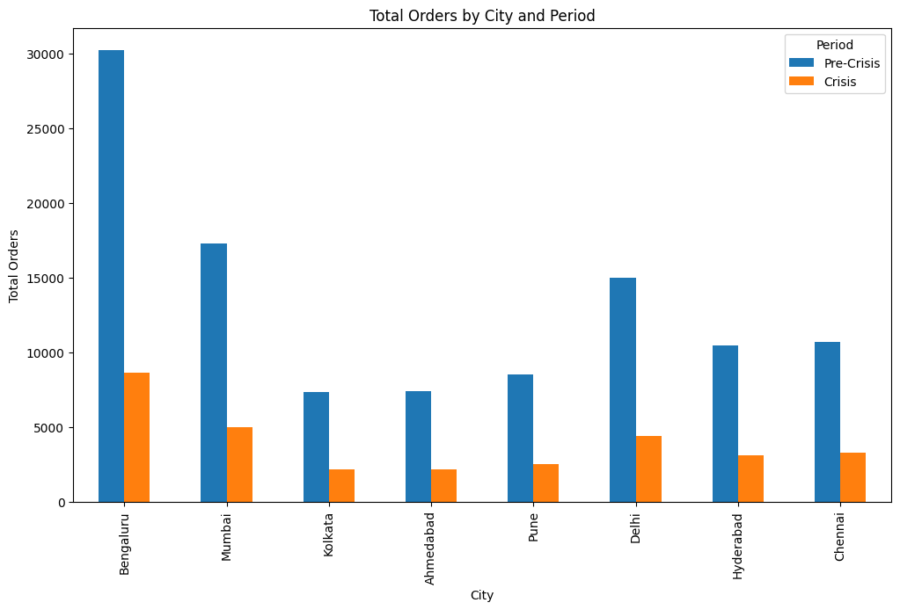
EDA -2 Which top 5 city groups experienced the highest percentage decline in orders
Confirms Absolute Drop: As we saw visually, Bengaluru had the largest absolute decline, losing 21,578 orders. This is followed by Mumbai (12,307) and Delhi (10,592), which were the three largest markets.
Confirms Relative Impact: This table strongly supports the key insight that the crisis's impact was remarkably uniform. The "Decline %" for all top cities is tightly clustered between 69.32% and 71.40%.

Slide 10
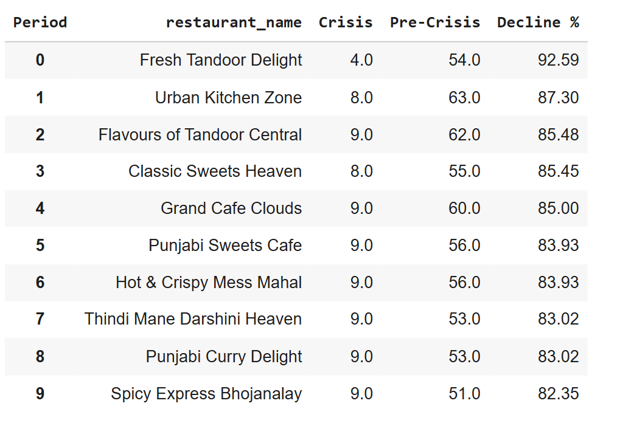
EDA-3 Among restaurants with at least 50 pre-crisis orders, which top 10 high-volume restaurants experienced the largest percentage decline in order counts during the crisis period?

Slide 11
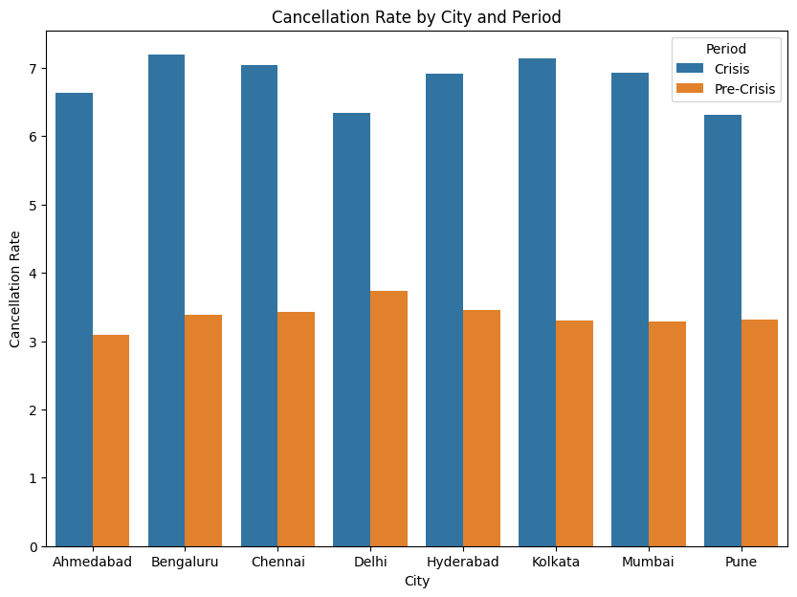
Eda-4 Cancellation Analysis: What is the cancellation rate trend pre-crisis vs crisis, and which cities are most affected?
This indicates that for every 100 orders placed during the crisis, 12 failed. This isn't just lost revenue; it's an actively bad customer experience that damages brand trust and loyalty.
This means that during the crisis, orders were being cancelled at almost twice the rate as before. This suggests significant operational issues, suchas restaurants being unable to fulfill orders, delivery partners being unavailable, or customers changing their minds due to uncertainty.
While this was a system-wide failure, the operational breakdown was most severe in Kolkata and Ahmedabad, where cancellation rates exploded by over 114%. This suggests the teams in those cities were the least prepared to handle the crisis, while Delhi proved to be the most resilient.

Slide 12

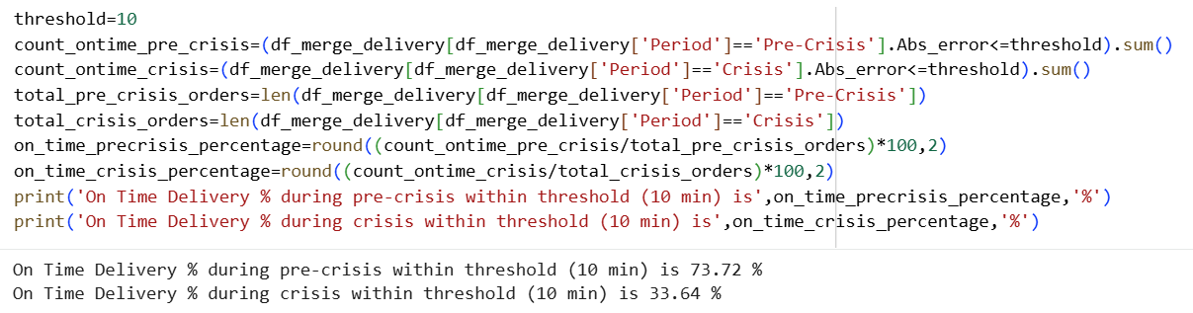
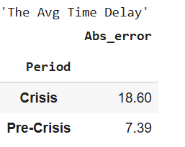

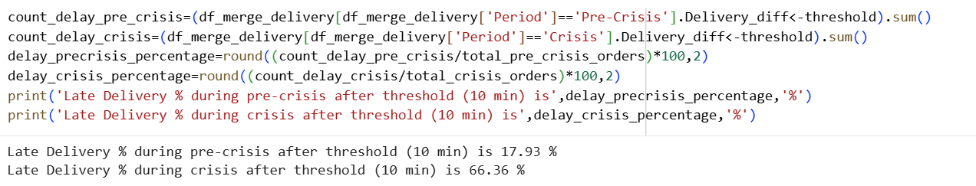
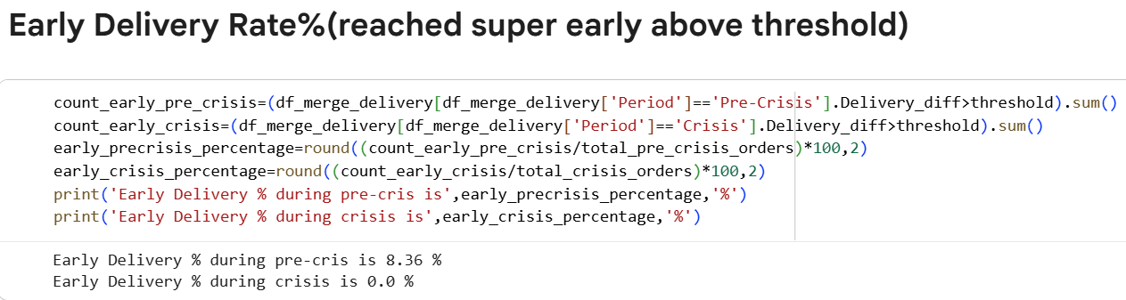
EDA-5 Delivery SLA: Measure average delivery time across phases. Did SLA compliance worsen significantly in the crisis period?
As per Industry standards delivery time threshold is 10–15-minute deviation from the Estimated Time of Arrival (ETA) is typically seen as being within the customer's "zone of tolerance“, so we took 10 min as the delivery threshold.
Pre-Crisis: The average time delay was 7.39 minutes. This is a manageable operational variance.
Crisis: The average time delay exploded to 18.60 minutes.
More orders were late: 66% of all deliveries missed the 10-min SLA window.
They were much later: Those orders weren't just a little late; they were arriving, on average, 18.6 minutes behind schedule.

Slide 13
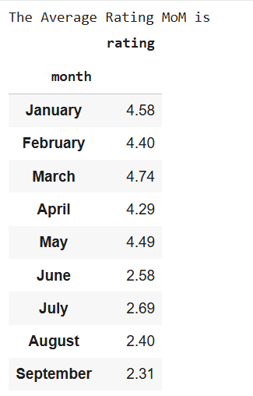
EDA -6 Ratings Fluctuation: Track average customer rating month-by-month. Which months saw the sharpest drop?
The single sharpest drop in average customer ratings occurred between May and June.
May Rating: 4.49
June Rating: 2.58
This represents a massive drop of 1.91 points in a single month.
Key Insight: As the line graph visually confirms, customer ratings were stable and high (all above 4.2) from January to May. The drop from May to June is a "cliff-edge" fall, directly correlating with the "Crisis" period
The data shows that customers were severely impacted by the service breakdown and responded with extremely low ratings, wiping out all the goodwill built up in the pre-crisis period.

Slide 14
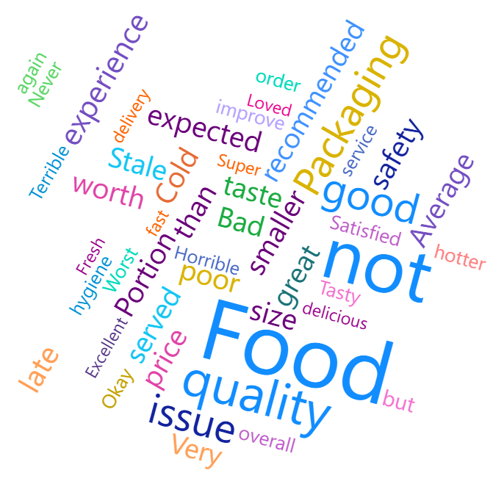
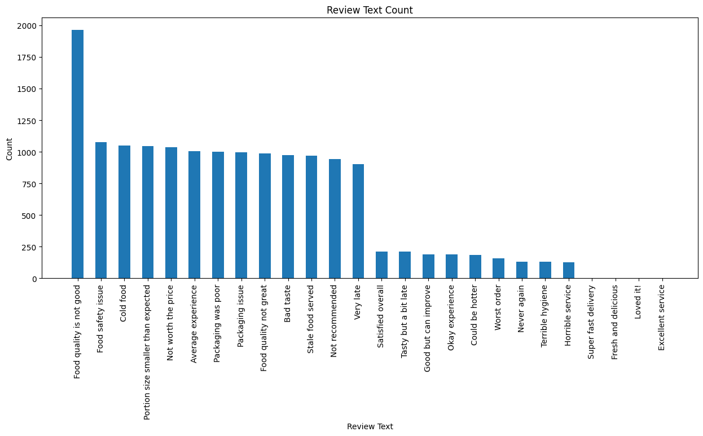
EDA-7 Sentiment Insights: During the crisis period, identify the most frequently occurring negative keywords in customer review texts.
In this I have used Power BI Word Cloud visual for identify the most frequently occurring negative keywords.
Based on the word cloud, the most frequently occurring negative feedback is clustered around food quality and delivery issues.
On Food Quality & Condition: Cold, Bad, Stale, Horrible, Worst, poor
On Delivery & Experience: late, Terrible experience, Never again
On Portioning & Value: smaller, Portion
This sentiment analysis directly correlates with the other findings: customers were receiving their orders late (which explains "Cold" food) and were having a "Terrible experience" due to the high cancellation and delay rates.

Slide 15
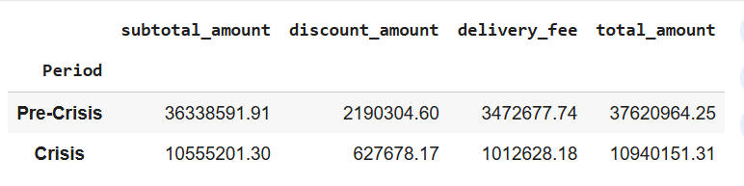
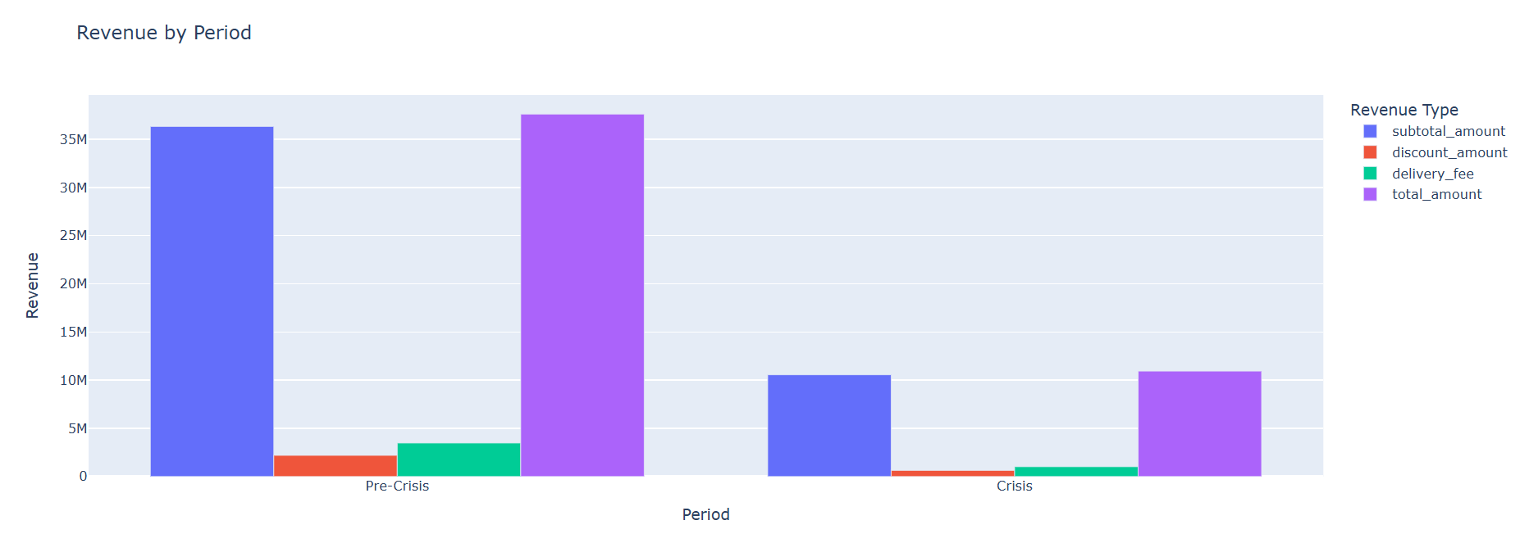
EDA-8 Revenue Impact: Estimate revenue loss from pre-crisis vs crisis (based on subtotal, discount, and delivery fee).
The revenue loss was catastrophic, dropping by 26,680,812.94, which represents a 70.92% decline.
The Most Critical Insight: AOV Remained Stable
  Order Volume Decline: ~70-71%
  Revenue Decline: 70.92%
The revenue collapse was not because customers were spending less per order. The problem was not pricing or value. The revenue loss was a direct, proportional symptom of two core problems:
  Massive Drop in Demand: A ~70% drop in order volume.
  Operational Failure: A doubling of the cancellation rate (to 11.93%), meaning that even when you did get an order, you failed to fulfill it 1 out of 8 times, wiping out that potential revenue.

Slide 16
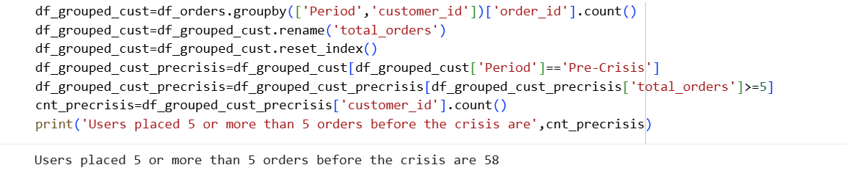
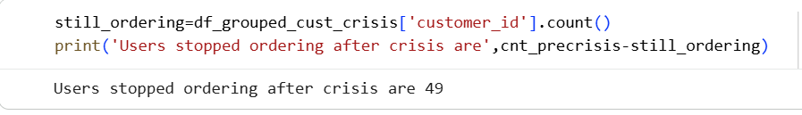
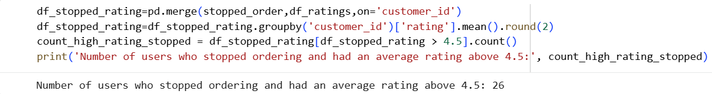
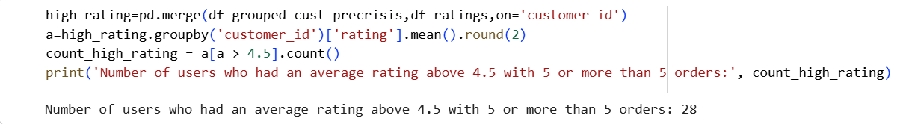
EDA-9 Loyalty Impact: Among customers who placed five or more orders before the crisis, determine how many stopped ordering during the crisis, and out of those how many had an average rating above 4.5?
Mass Churn of Loyal Users (84.5%):
  There was a core group of 58 loyal customers who had each placed 5 or more orders before the crisis.
  Of those 58, 49 stopped ordering during the crisis.
  This is an 84.5% churn rate among most active, high-frequency users.
Near-Total Loss of "Promoters" (93%):
  Within that loyal group, there were 28 "promoters"— best customers who both ordered frequently and gave high ratings (> 4.5).
  Of those 28, 26 stopped ordering.
  This is a 93% churn rate among biggest fans and advocates.

Slide 17
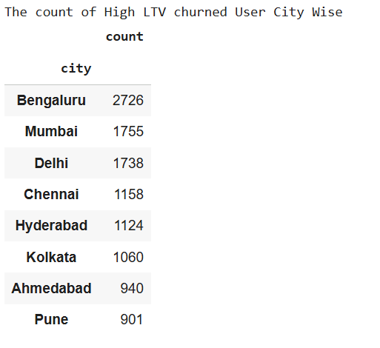
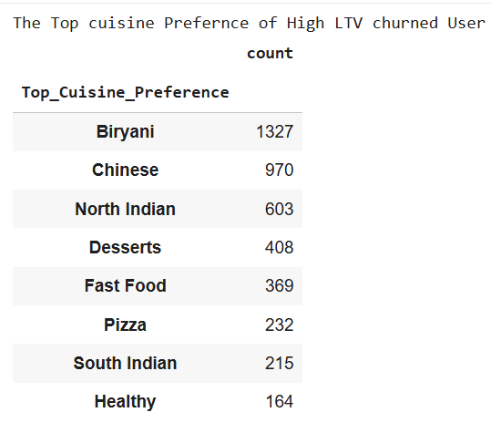
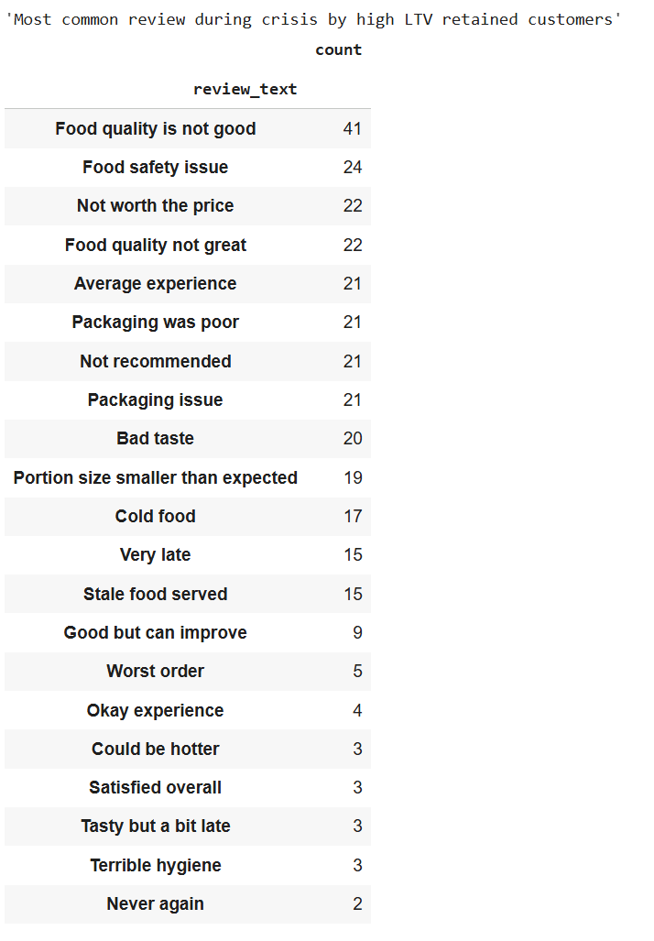
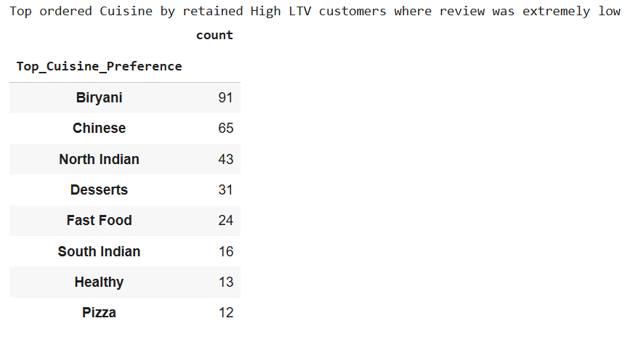
EDA-10 Customer Lifetime Decline: Which high-value customers (top 5% by total spend before the crisis) showed the largest drop in order frequency and ratings during the crisis? What common patterns?
Pattern 1: Location (City) The churn of HVCs was concentrated in the largest, most important markets.
  Bengaluru: 2,726 HVCs were lost
  Mumbai: 1,755 HVCs were lost
  Delhi: 1,738 HVCs were lost This shows the operational failure was worst in the very cities that were the engine of the business.
Pattern 2: Cuisine Preference The data shows a clear preference among both churned HVCs and the retained-but-unhappy HVCs.
  Top Cuisines for Churned HVCs: Biryani (1,327), Chinese (970), North Indian (603).
  Top Cuisines for Unhappy Retained HVCs: Biryani (91), Chinese (65), North Indian (43).
  Insight: The pattern is identical. The problem was not the cuisine type. The problem was a complete failure to deliver these popular cuisines acceptably.
Pattern 3: The Service Failure (The "Why") This is the root cause. The "delivery delays" and other issues are why they left. The most common complaints from these HVCs are:
  Food quality is not good (41)
  Food safety issue (24)
  Cold food (17)
  Very late (15)

Slide 18
Summary
The revenue drop(~70-71%) and order drop(70.92%) were identical. This proves the Average Order Value (AOV) was stable. The problem wasn't pricing; it was a massive disengagement of the entire customer base.
SLA (Delivery) Failure: The average delay more than doubled, from 7.4 minutes to 18.6 minutes which means The late delivery rate skyrocketed from 18% to 66.36%. (Two-thirds of all orders were late).
The overall cancellation rate nearly doubled from 6.06% to 11.93% , Kolkata and Ahmedabad saw the worst relative breakdown, with cancellation rates exploding by over 114%.
Customer Experience: Average ratings were stable and high (4.2-4.7) until May (4.49). In June, they fell off a cliff to 2.58. The top complaints were "Food quality issue," "Cold," "late," "Bad," and "Terrible experience”. The data proves that the 18.6-minute average delay directly caused the "cold food" and "bad quality" complaints, which in turn caused the ratings to collapse.
The company lost 84.5% (49 out of 58) of its high-frequency customers (those with 5+ pre-crisis orders). The damage was even worse among the best customers. Of the 28 "promoters" (high-frequency users who also gave >4.5 ratings), 26 left—a 93% churn rate results in the increase in CAC .

Slide 19
RECOMMENDATIONS

